Slide 1
University of Illinois REU Introduction to Matlab Day II
Compiled by Erik Huemiller

Slide 2
Goals for Today
Start with
Skills from Day One of the Crash Course
End with
Ability to import data
Plot 2 graphs on the same plot
Fit the data to a function

Slide 3
Resources if you get stuck
Matlab Documentation (online)
Easiest to find through a Google search of “Matlab + command”
There is example code with an explanation of most commands
Links to similar commands are listed at the bottom of the page
BYU Intro to Matlab
Loosely used as an outline for this crash course
PDF with less explicit cross references than the online material
Weitzman Institute
PDF and PPT lectures with slides and example code
Slow moving course designed for people that have never coded before.
Email grad student mentor with questions
Slower response, but can give individual feedback
Can meet up in person to work through a tough problem
Has experience fitting data similar to the data you are fitting in your field

Slide 4
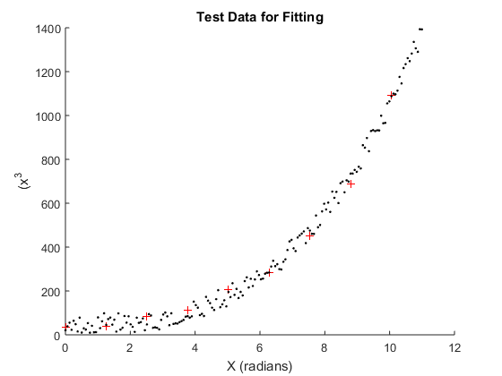
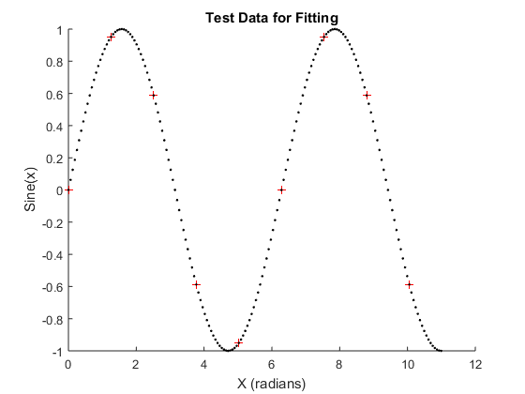
Creating some test Data
Before we get too far into plotting and fitting, we want to have some test data to play around with.
Try to write a program that will create some test data for us to fit to. Have 2 sets of data for each function, a low sample set and a high sample set.
A Polynomial Function with some noise on top of the data
1-2 periods of a sine function.
Then plot both of the data sets on the same graph to check that they infact overlap.

Slide 5
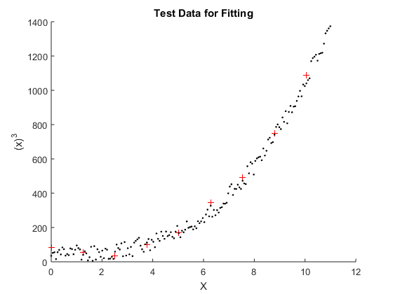
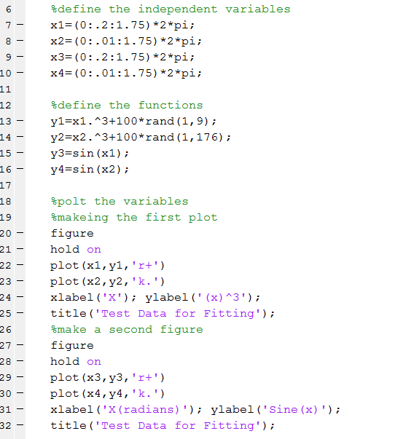

This is what mine looks like

Slide 6
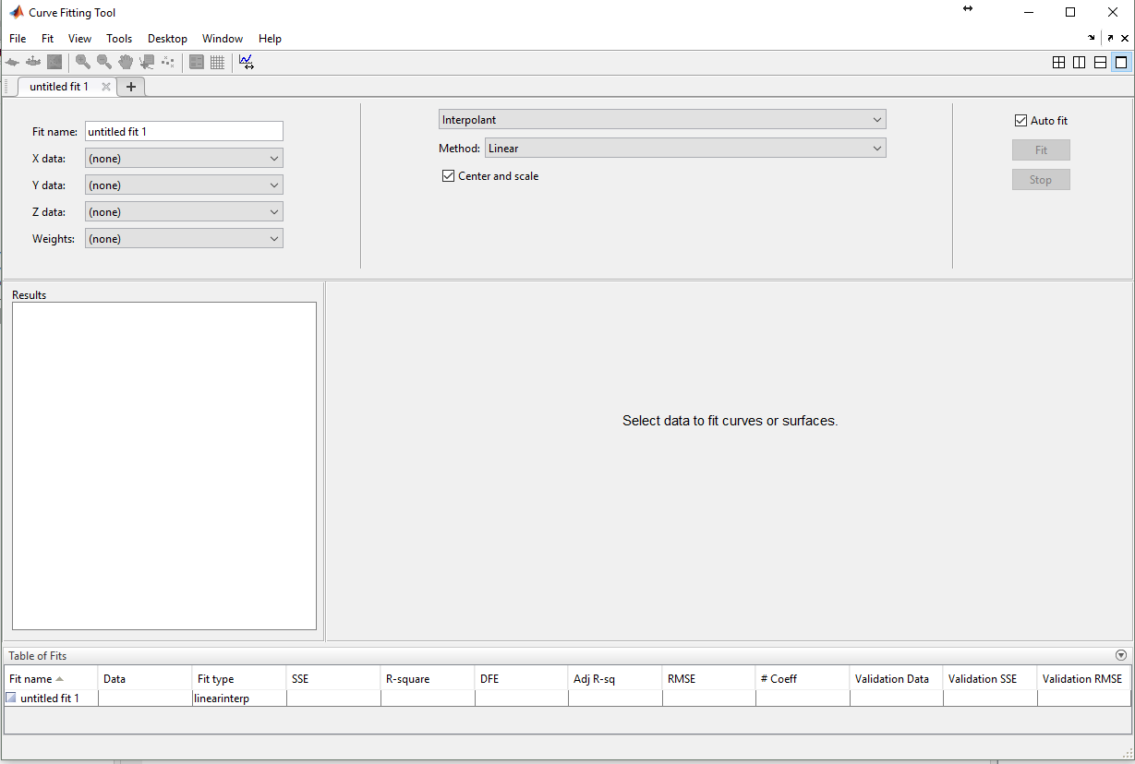
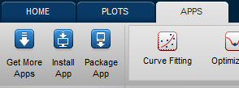
Fitting data to a Function
Using the GUI is the easiest way to generate code
With the Data in your workspace, open the fitting app
Select the variables to fit, and the fit type
Fit type
Variables to fit
Try setting up a fit to the test data you generated
Can you use the polynomial fit to get the polynomial expansion for your sine function?

Slide 7
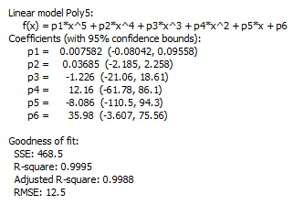
Analyzing the Fit
The Fitting App gives a quality of fit
Try adding more and more random noise to your data and see what happens to the different goodness of fit parameters.

Slide 8
Importing Data
Using Code – Matlab has support for importing a large variety of different file formats (see here). For today we will stick to using csv files (csvread and csvwrite commands).
Like we did yesterday, if you have the data file downloaded you can drag and drop it into the workspace to import the data.
Try downloading the sample functions in the Github folder and figure out what the functions are. If there is extra time, download the Boston marathon Data, and try fitting the outcomes to different functions (histograms to Gaussians etc)

